Slide 1
Efficient Acoustic Modelling of Large Spaces Using Time Domain Methods
Work So Far

Slide 2

What we will cover
Context
Plan
Validation
Work So Far
Finite Difference Time Domain
Pseudo Spectral Time Domain
Sparse Finite Difference Time Domain
Next Steps
Code Review

Slide 3

Context
Acoustic modelling is continually being applied to larger and more varied use cases e.g:
Video Game Auralization
Virtual Reality Auralization
Scientific Simulation
Cinematography
Architectural Design
Loudspeaker System Engineering

Slide 4
Context
Computing speed and power continues to increase, allowing time domain numerical methods to be a more realistic option
Time domain numerical methods may be optimised to provide:
Time domain numerical methods have a few issues:
Appropriately accurate results for auralization applications
[eventually in real time]
Results for arbitrary and dynamic numbers of sources and receivers without fundamentally changing the calculation
Impulse responses or signal data without significant changes in kernel equation i.e. flexible code
Require a significant number of calculations per time step
Exponentially more with frequency
Explicit Euler methods have relatively high error
Applying these methods to very large simulations may not allow for feasible calculation times
The amount of memory required for large simulations may be implausibly large

Slide 5
Context
The aim of this study is to:
Develop and explore three numerical methods for acoustic simulation
The Finite Different Time Domain Method
The Pseudo-spectral Time Domain Method
The Sparse Finite Difference Time Domain Method
Bench mark all three methods and compare execution time for a small domain
Bench mark all three domains and compare execution time for a very large domain
If successful, apply parallel processing to each algorithm and compare benchmarks
Document study

Slide 6
Plan
Benchmark
Optimize / Validate
Benchmark / Document
Data Handling Strategy
FDTD
1D
sub-validate
2D
sub-validate
3D
Validate
PSTD
1D
sub-validate
2D
sub-validate
3D
Validate
SFDTD
1D
sub-validate
2D
sub-validate
3D
Validate
Kernel Prototype
Test
Partially Absorbing Boundary Development
Sub-validate
Domain Instantiation
Reading on PSTD
Reading on FDTD & SFDTD
Reading on data handling strategies

Slide 7

Validation
1D
34m domain excluding boundaries
‘Time of flight’ 1mS
Boundary absorption
1 = pass-through [0dB across grid after 1ms + source prop time ]
0 = perfect reflection [0dB of aggregate loss after source prop for 1s sim time]
Sim must be stable up to 48kHz
2D
10m * 10m domain
‘Time of flight’ to multiple receivers
Receivers in line, peak level should reduce following inverse square law
Sim must be stable up to 48kHz
3D
5m * 4m * 3m domain
‘Time of flight’ should be concurrent with 2D and speed of sound
Peak of receivers should match inverse square law
Sim must be stable up to 48kHz
Impulse response must cross-correlate with image source model to higher than 0.5 coefficient
Spectral shifting is expected due to soft source implementation

Slide 8

Benchmarking
Small Domain
34m domain excluding boundaries
‘Time of flight’ 1mS
Boundary absorption
1 = pass-through [0dB across grid after 1ms + source prop time ]
0 = perfect reflection [0dB of aggregate loss after source prop for 1s sim time]
Sim must be stable up to 48kHz
Large Domain
10m * 10m domain
‘Time of flight’ to multiple receivers
Receivers in line, peak level should reduce following inverse square law
Sim must be stable up to 48kHz

Slide 9
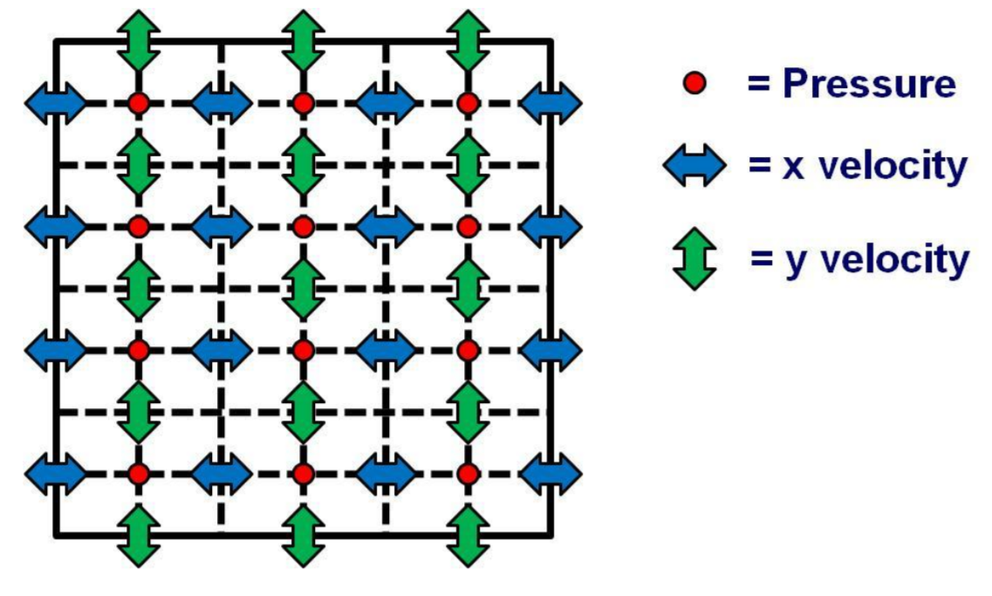
Finite Difference Time Domain
Staggered grid constitutive relation
Pressure
Velocity
Linearized Navier-Stokes Approximation
Forward Euler method
2nd order in space
2nd order in time
Requires 6~10 points per wavelength
Explicit
Local differentiation of finite points in space
Marching forward in half steps of time
Implementation based on work by Hill
A. J. Hill, “Analysis , Modelling and Wide-Area Spatiotemporal Control of Low-Frequency Sound Reproduction,” no. January, 2012.

Slide 10
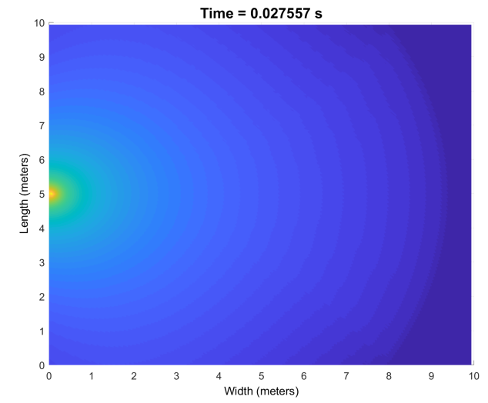
Finite Difference Time Domain
Staggered grid constitutive relation
Pressure
Velocity
Linearized Navier-Stokes Approximation
Forward Euler method
2nd order in space
2nd order in time
Requires 6~10 points per wavelength
Explicit
Local differentiation of finite points in space
Marching forward in half steps of time

Slide 11
Finite Difference Time Domain
1D
Kernel - Complete
Absorbing Boundaries – Complete
Sub-validation - Complete
2D
Kernel - Complete
Absorbing Boundaries – Complete
Sub-validation – Incomplete
3D
Kernel - Complete
Absorbing Boundaries – Complete
Sub-validation – Incomplete
Validation – Incomplete
Benchmarking - Incomplete
Optimisation - Incomplete

Slide 12
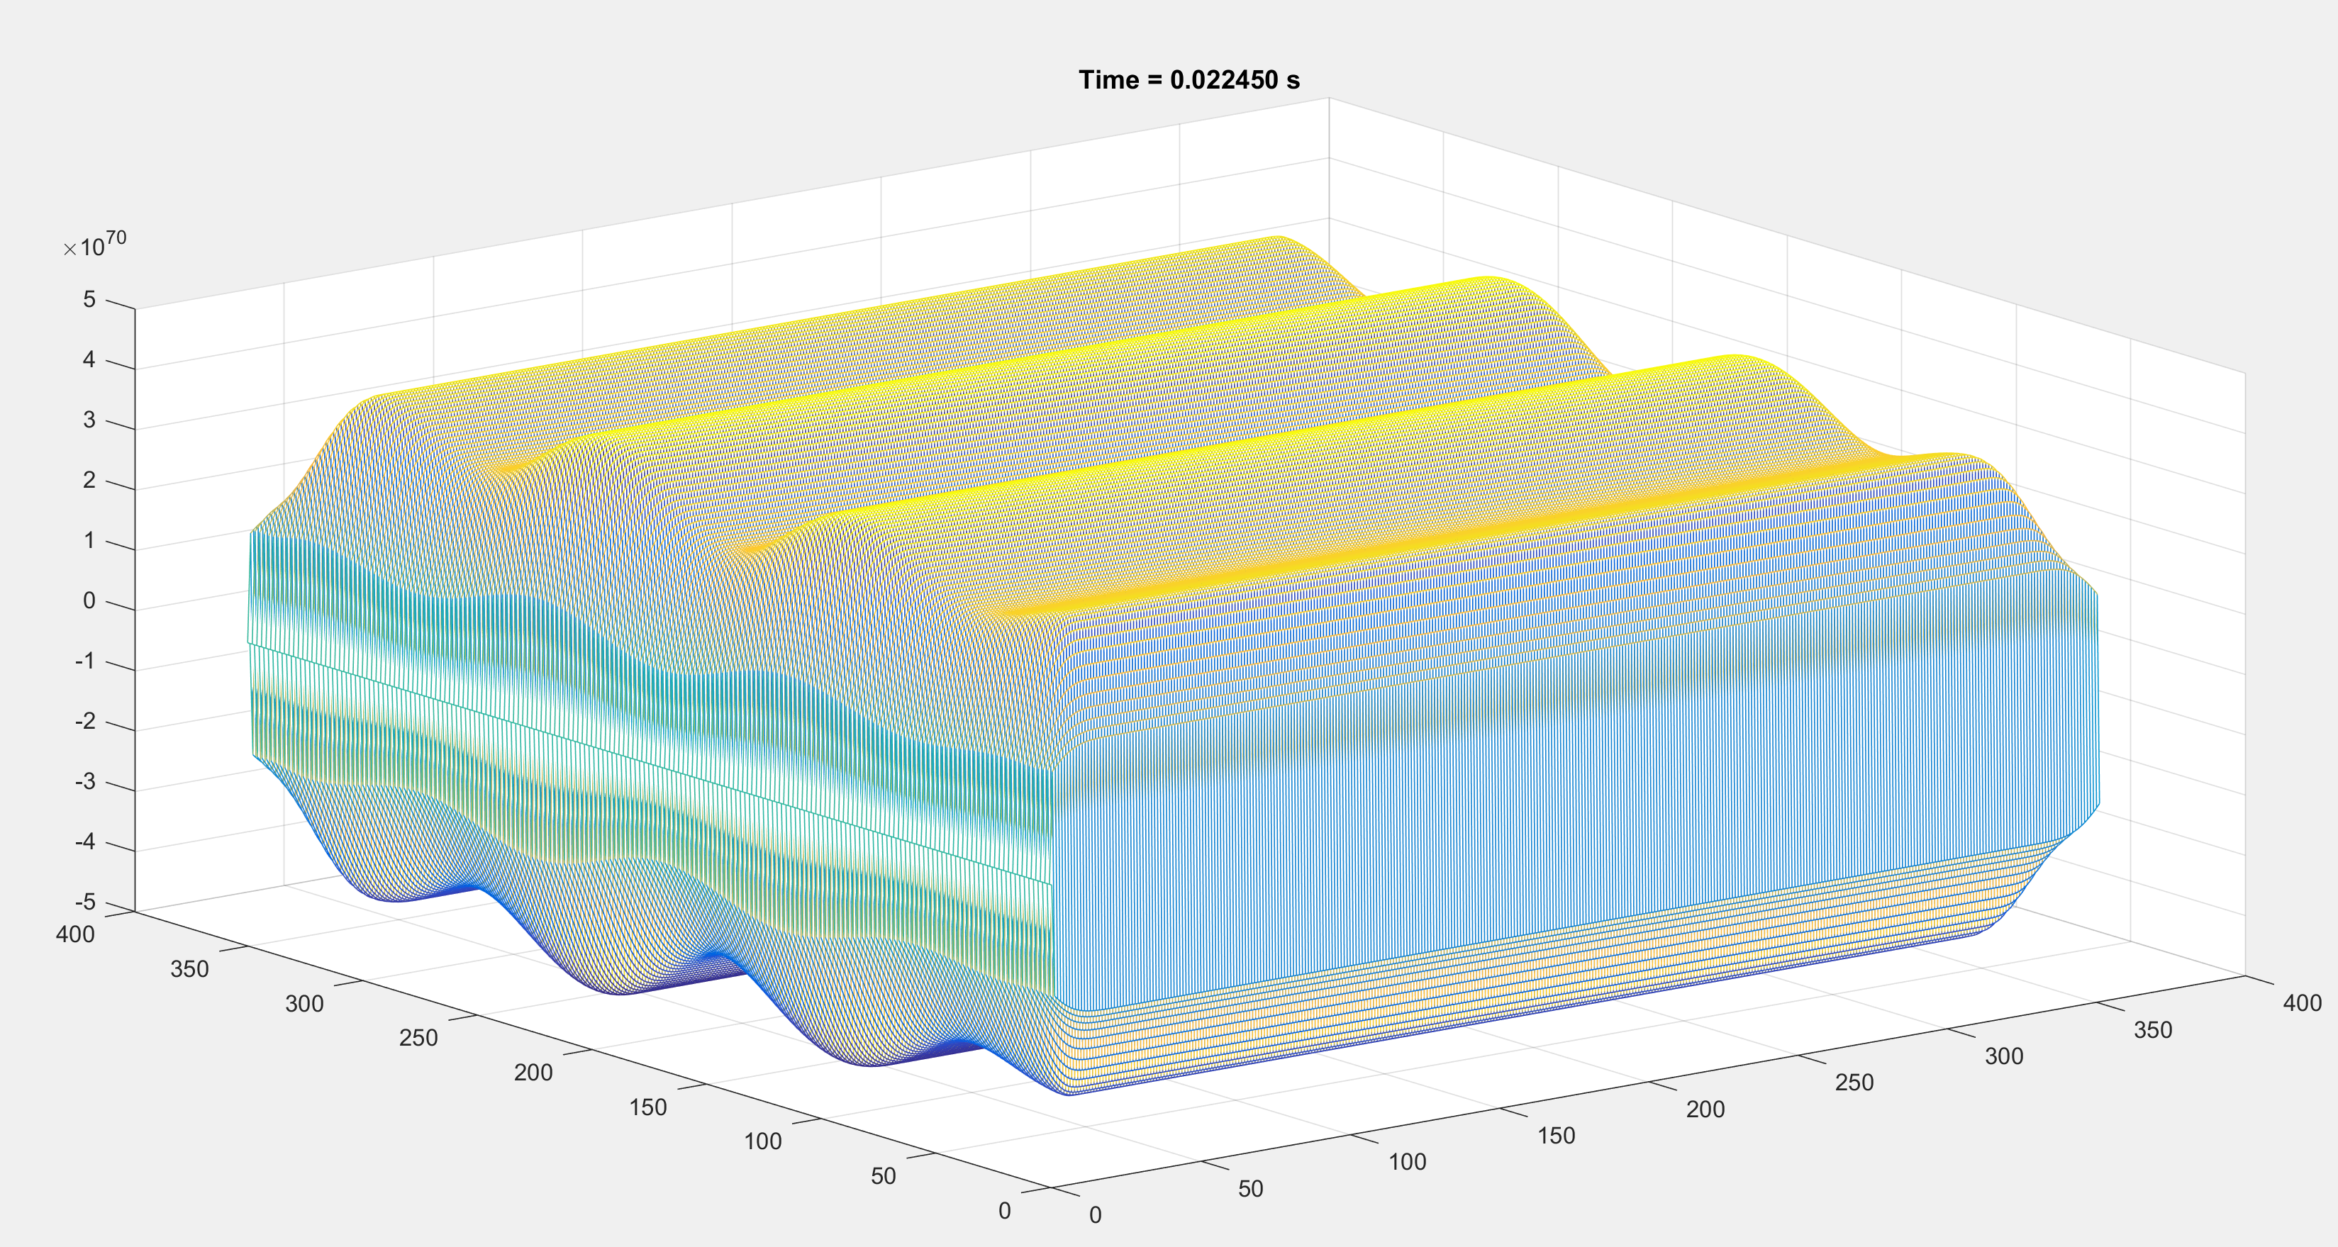
Pseudo-spectral Time Domain
Uniform grid locations
Differentiation occurs in frequency domain
Differentiation across number of points in dimension
Error of order 2^NlogN
2nd order in time
Obeys Nyquist sampling theorem
2 points per wavelength minimum
Marching forward in half steps of time
Implementation based on work by Angus & Caunce
J. A. S. Angus and A. Caunce, “A GPGPU Approach to Improved Acoustic Finite Difference Time Domain Calculations,” 128th Audio Eng. Soc. Conv., 2010.

Slide 13
Pseudo Spectral Time Domain
1D
Kernel - Complete
Absorbing Boundaries – Complete
Sub-validation - Incomplete
2D
Kernel - Incomplete
Absorbing Boundaries – Incomplete
Sub-validation – Incomplete
3D
Kernel - Incomplete
Absorbing Boundaries – Incomplete
Sub-validation – Incomplete
Validation – Incomplete
Benchmarking - Incomplete
Optimisation - Incomplete
1D
May require filtering the domain at each step to accommodate for high frequency aliasing due to non-smooth boundaries
2D
Currently Unstable, probably due to PML scaling
3D
Waiting for further completing of 2D

Slide 14
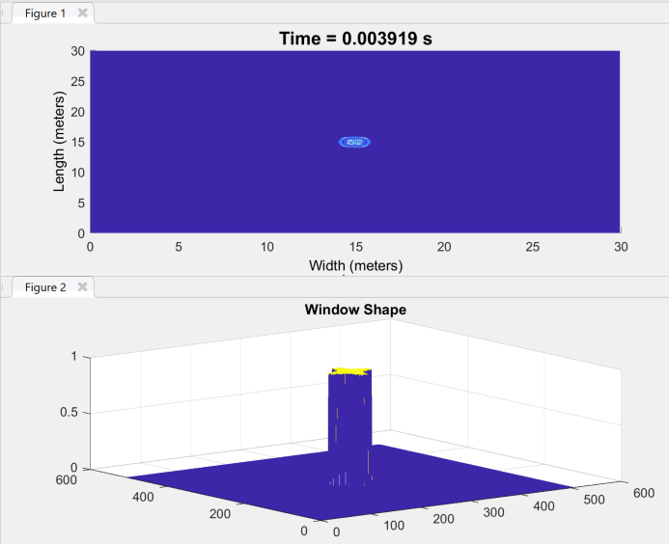
Sparse Finite Difference Time Domain
Similar solving to FDTD
Solves local points where energy is above a threshold
Indexing function to determine points to be solved
Differentiation across number of points in dimension
May improve solving speed when the number of operations performed is less than the number of active grid points
May only improve performance when the dynamic range of the simulation is quite high
Based on work by Christopher Doerr, applied to the FDTD work based on Hill
C. Doerr, “Sparse Finite Difference Time Domain Method,” IEEE Photonics Technol. Lett., vol. 25, no. 23, pp. 1–1, 2013.

Slide 15
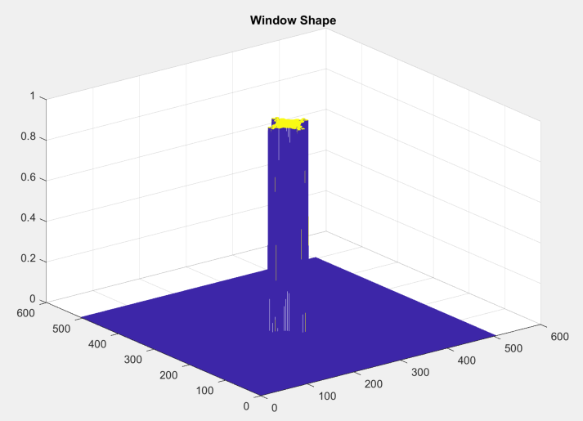
Sparse Finite Difference Time Domain
0 pad ends of the domain
Decimate domain
Normalise values by threshold
Floor matrix
Reduce values above 1 to 1
Interpolate grid back to correct size
Ceil matrix

Slide 16
Sparse Finite Difference Time Domain
1D
Kernel – In Progress
Absorbing Boundaries – Complete
Sub-validation - Incomplete
2D
Kernel - Complete
Absorbing Boundaries – Complete
Sub-validation – Incomplete
3D
Kernel – In Progress
Absorbing Boundaries – Complete
Sub-validation – Incomplete
Validation – Incomplete
Benchmarking - Incomplete
Optimisation - Incomplete
1D
Window function is not smoothing enough- making the simulation unstable
2D
Further confirmation of numerical dispersion not oscillating required, but looks promising
3D
Yet to generate stable solving kernel, but work is in progress

Slide 17

Next Steps
Fault find 1D SFDTD windowing algorithm
More points
Interpolate first?
Experiment with SFDTD noise floor
Get 3D SFDTD working
Fault find PSTD1D
Why is the wave propagating 20 times slower?
Get 2D and 3D PSTD working
Create validation info from Image-Source program
Record validation results of FDTD 2nd order in all three dimensions
Optimisation [GPGPU]
Implement 4th order FDTD [nice to have]
Continue to write report / Documentation

Slide 18

Code Review

